Slide 1
2025 PRE-LEGISLATIVE DAY WEBINAR
FEBRUARY 26, 2025
10:00 AM

Slide 2
PRE-LEGISLATIVE DAY WEBINAR
MARCH 19, 2025
8AM
CHALLENGER LEARNING CENTER
IMAX THEATER
200 SOUTH DUVAL STREET, TALLAHASSEE
TERRY BURROUGHS
PRESIDENT, 2024-2025
OKEECHOBEE COUNTY

Slide 3
AGENDA
BEFORE YOU ARRIVE
WELCOME TO TALLAHASSEE
MAKING THE MOST OF YOUR TRIP
WHEN YOU GET HOME

Slide 4
PRE-LEGISLATIVE DAY WEBINAR
BEFORE YOU ARRIVE
MAKE APPOINTMENTS
with members of your delegation

Slide 5
PRE-LEGISLATIVE DAY WEBINAR
BEFORE YOU ARRIVE
Find your Representative(s)
Representatives
myfloridahouse.gov/findyourrepresentative

Slide 6
PRE-LEGISLATIVE DAY WEBINAR
BEFORE YOU ARRIVE
Find your Senator
Senator
flsenate.gov/senators/find

Slide 7
PRE-LEGISLATIVE DAY WEBINAR
BEFORE YOU ARRIVE
Send them an email
Representatives
first.last@myfloridahouse.gov
Senator
last.first.web@flsenate.gov

Slide 8
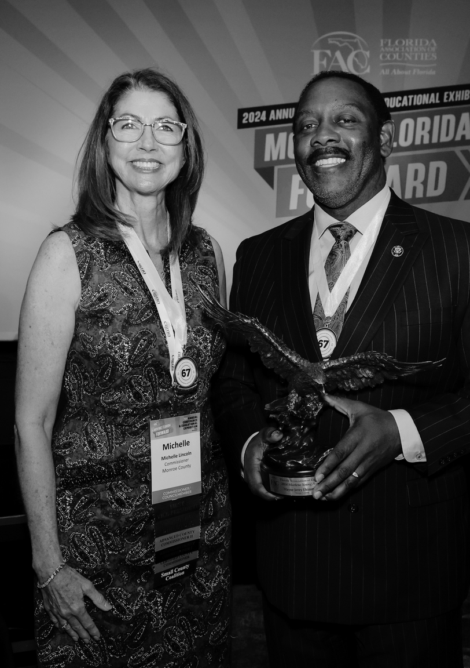
PRE-LEGISLATIVE DAY WEBINAR
IMPORTANT!
ALWAYS INCLUDE THE AIDE(S) WHEN EMAILING REPRESENTATIVE OR SENATORS

Slide 9
PRE-LEGISLATIVE DAY WEBINAR
UNDERSTAND THE ISSUES
FACPolicy.com
Check in with your
COUNTY
Policy Positions
Latest Updates
Bill Tracker
Pre-emption tracker

Slide 10
Speakers:
WILTON SIMPSON
Commissioner, Department of Agriculture and Consumer Affairs
ALEXIS LAMBERT
Secretary of Department of Environmental Protection
JAMES S. HARTSELL
Director of Department of Veterans Affairs

Slide 11
DAVIN SUGGS
Deputy Executive Director of Florida Association of Counties
ALEX KELLY
Secretary of Department of Commerce
MELANIE GRIFFIN
Secretary of Department of Business & Professional Regulation

Slide 12
PRE-LEGISLATIVE DAY WEBINAR
WELCOME TO TALLAHASSEE
SCHEDULE
FINDING YOUR WAY AROUND
LEGISLATOR MEETINGS

Slide 13
PRE-LEGISLATIVE DAY WEBINAR
WELCOME TO TALLAHASSEE
7:00 A
Registration & Breakfast
CHALLENGER LEARNING CENTER
imax theater
8:00 A
FAC Legislative Briefing
200 s duval street
Afternoon
Legislator Appointments
5:30 P - 7:00 P
Reception
@Eve on Adams, Rooftop of
the Doubletree Hotel

Slide 14
PRE-LEGISLATIVE DAY WEBINAR
WELCOME TO
Macomb
TALLAHASSEE
CHALLENGER LEARNING CENTER
imax theater
OFFICES
200 s duval street
Pensacola Street
Apalachee Parkway
Monroe

Slide 15
PRE-LEGISLATIVE DAY WEBINAR
LUNCH!
Macomb
CHALLENGER LEARNING CENTER
imax theater
OFFICES
200 s duval street
Pensacola Street
Apalachee Parkway
METRO DELI
104
N. MONROE
ASSEMBLY ON ADAMS
225
S. ADAMS
Monroe
GOODIES
116
E. COLLEGE
EGG EATERY
300
S. DUVAL
HAYWARD HOUSE
228
S. ADAMS
HARRY'S
301
S. BRONOUGH ST

Slide 16
PRE-LEGISLATIVE DAY WEBINAR
MAKING THE MOST OF YOUR TRIP
GETTING AROUND THE CAPITOL
GREAT LEGISLATIVE MEETINGS
FINDING LEGISLATION
WANT TO TESTIFY?

Slide 17
PRE-LEGISLATIVE DAY WEBINAR
GETTING
AROUND THE
CAPITOL

Slide 18
LEGISLATIVE MEETINGS
Know your #1
AND be able to articulate it in under 60 seconds
You know where they live
Don't try to squeeze it all in! It's a great excuse to invite them to lunch & see them again!

Slide 19
PRE-LEGISLATIVE DAY WEBINAR
FINDING A BILL
HOUSE BILL
SENATE BILL
myfloridahouse.gov
flsenate.gov

Slide 20
PRE-LEGISLATIVE DAY WEBINAR
WANT TO TESTIFY?
Located in the back of (every) committee room!

Slide 21
PRE-LEGISLATIVE DAY WEBINAR
RECEPTION
Macomb
CHALLENGER LEARNING CENTER
imax theater
OFFICES
17th floor of DoubleTree
200 s duval street
Reception!
Reception!
EVE ON ADAMS
Pensacola Street
101 S Adams St
Apalachee Parkway
Monroe

Slide 22
PRE-LEGISLATIVE DAY WEBINAR
BEFORE YOU LEAVE
LUNCH
March 20-21, 2025
2025 Growth Management Workshop / Environmental Field Trip
Provided
both days!
Attend the two-day growth management/environment CCC class which includes a field trip to Tall Timbers research station and land conservancy (3/20) and in class growth management workshop (3/21). There is an additional registration fee of $125 for these sessions. Attendees will earn 6 hours of core credit and six hours of elective credits for the CCC / CGE programs
by attending both days. Please note that CCC participation requires that two classes be
taken in-person. Accordingly, ICG encourages participants take advantage of this
opportunity.

Slide 23
PRE-LEGISLATIVE DAY WEBINAR
WHEN YOU GET HOME
SEND A THANK YOU
SHARE YOUR TRIP W/ CONSTITUENTS
MAINTAIN THE RELATIONSHIP

Slide 24
SHARE IT!
And tag us!
@flcounties

Slide 25
PRE-LEGISLATIVE DAY WEBINAR
CALL ANYTIME
GINGER DELEGAL
DAVIN SUGGS
JEFF SCALA
CRAGIN MOSTELLER
gdelegal@fl-counties.com
dsuggs@fl-counties.com
jscala@fl-counties.com
cmosteller@fl-counties.com
(850) 294-9295
(850) 320-2635
(727) 637-4081
(850) 294-9307

