Slide 1
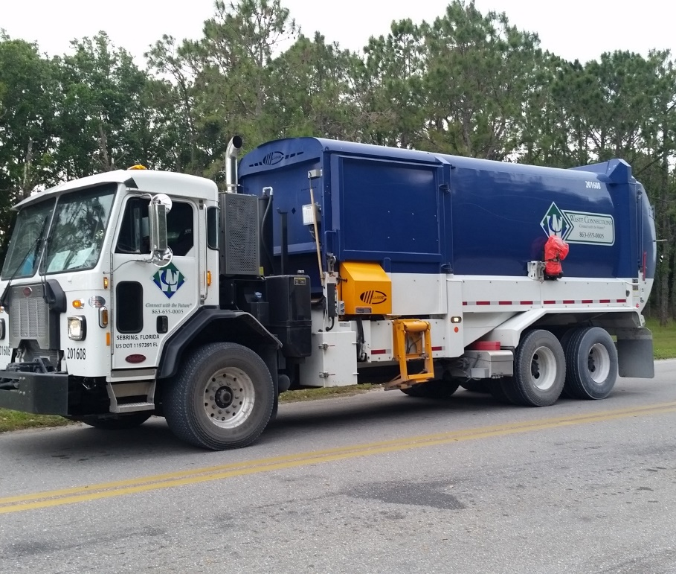
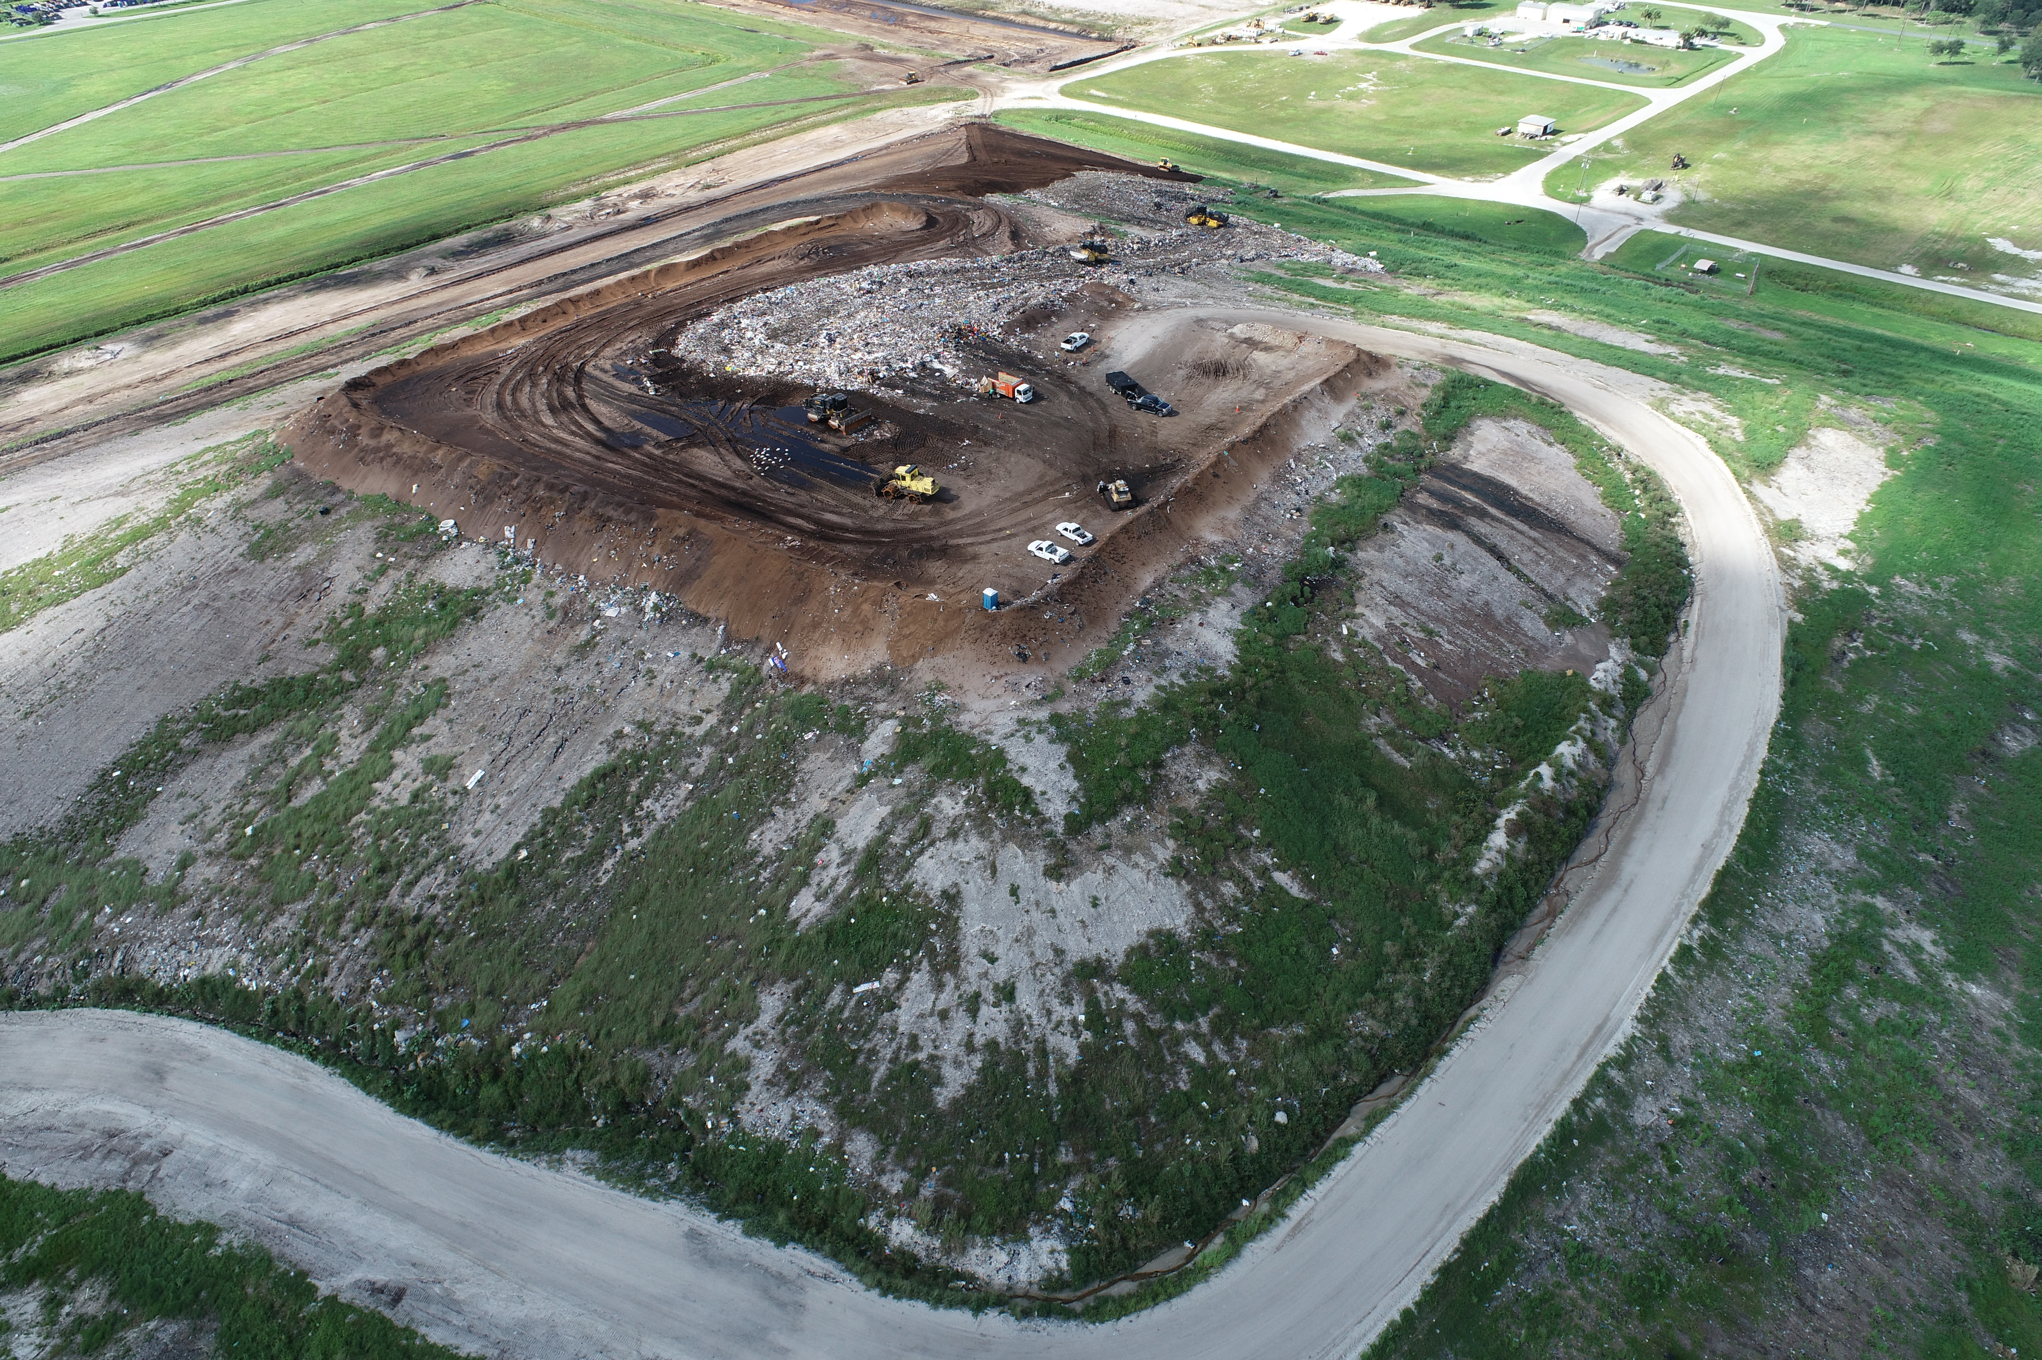
Stormwater – Public Works
Shane Williams, P.E., Stormwater Engineer, Alachua County
James Link, P.E., Civil Engineer II, Alachua County
Ramon D. Gavarrete, P.E., Public Works Director, Alachua County
Clinton “Gator” Howerton, Jr., P.E., CPM, Critical Infrastructure Director, Highlands County

Slide 2
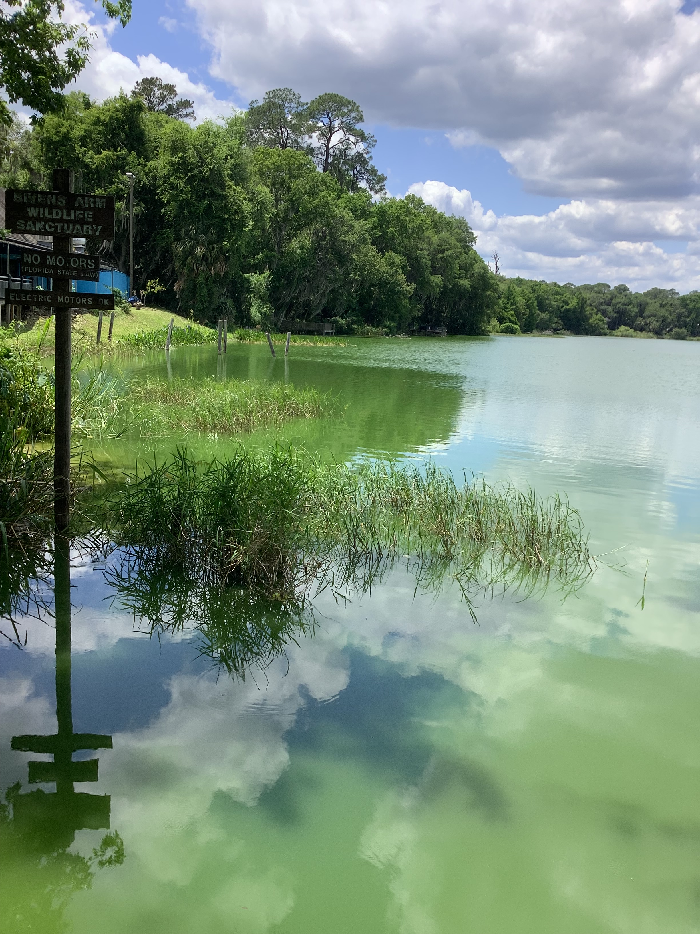
Stormwater and Water Quality
Stormwater runoff from developed land uses transports pollutants to waterbodies and groundwater.
Nutrients (nitrogen and phosphorus) are major pollutants in Florida and can cause harmful algal blooms.
Over time nutrient accumulation can change plant and fish composition.
Stormwater management systems must be designed to prevent pollutants from entering waterbodies.
Notes:
Eutrophication is the process by which a waterbody becomes enriched with nutrients.

Slide 3
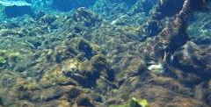
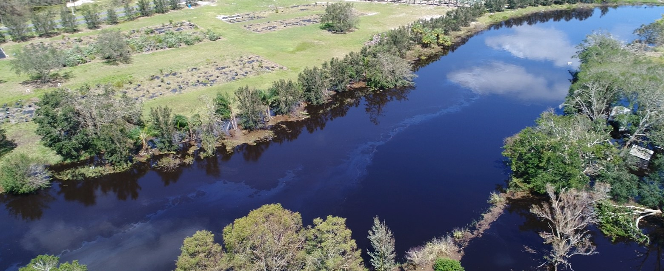
Stormwater and Water Quality
Stormwater from developed areas is regulated by the State through WMDs and by local governments.
Runoff from agricultural land uses is regulated by the State.
(See Chapter 62-40, F.A.C., Water Resource Implementation Rule) & Chapter 62-302, F.A.C., Surface Water Quality Standards) )
Notes:
Chapter 62-40, F.A.C. (Water Resource Implementation Rule) — provides water resource implementation goals, objectives, and guidance relating to water resources. This includes guiding principles for stormwater and surface water management programs (including the basis for minimum design criteria for the stormwater management systems), flood protection, natural systems protection and management, minimum flows and levels, and protection measures for surface water resources (including the goals for implementation of erosion and sediment control measures).
•Chapter 62-302, F.A.C. (Surface Water Quality Standards) — provides the State’s numeric and narrative water quality standards criteria for surface waters, lists the classes of waters in Florida, and lists waters that are designated as Outstanding Florida Waters. Also includes the state’s anti-degradation requirements.
State permits are called Environmental Resource Permits and are issued through the water management Districts.

Slide 4
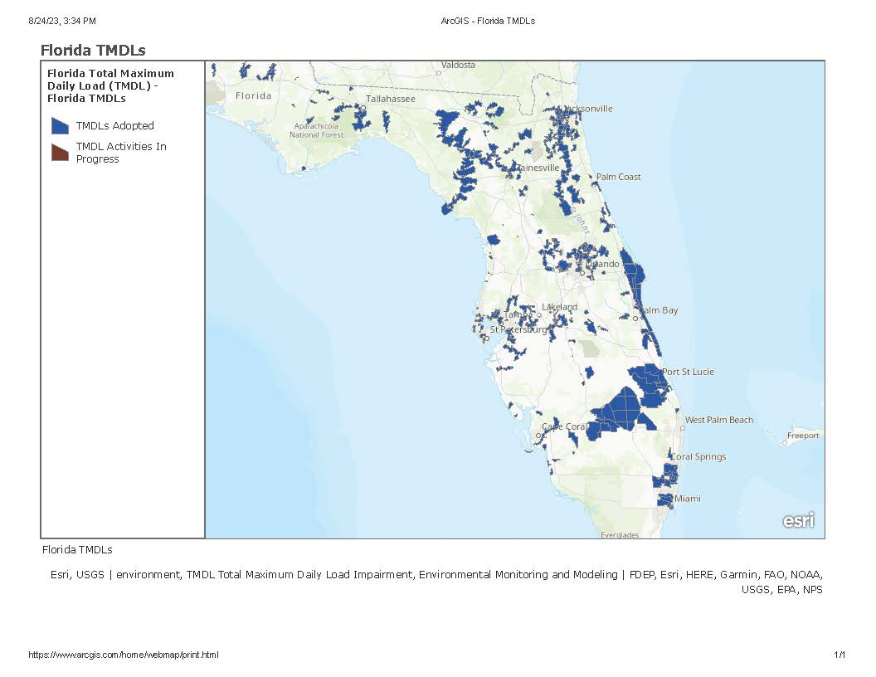
Impaired Waters Rule
Waterbodies that do not meet State water quality standards in 62-302 F.A.C. are identified as "impaired" for the pollutants causing the impairment.
Total Maximum Daily Loads must be developed, adopted and implemented to reduce those pollutants and clean up the waterbody.
(Chapters 62-303, Identification of Impaired Surface Waters, 62-304, Total Maximum Daily Loads, & 62-306, F.A.C., Water Quality Credit Trading)
Notes:
Chapters 62-303 (Identification of Impaired Surface Waters), 62-304, (Total Maximum Daily Loads), and 62-306, F.A.C. (Water Quality Credit Trading) — provide for identification of waters that do not meet state water quality standards and that are subject to pollution limits and recovery plans. Discharges of pollutants that cause or contribute to such impairment are subject to meeting net improvement requirements, as discussed in section 10.2.4.5 of this Volume and Volume II.

Slide 5
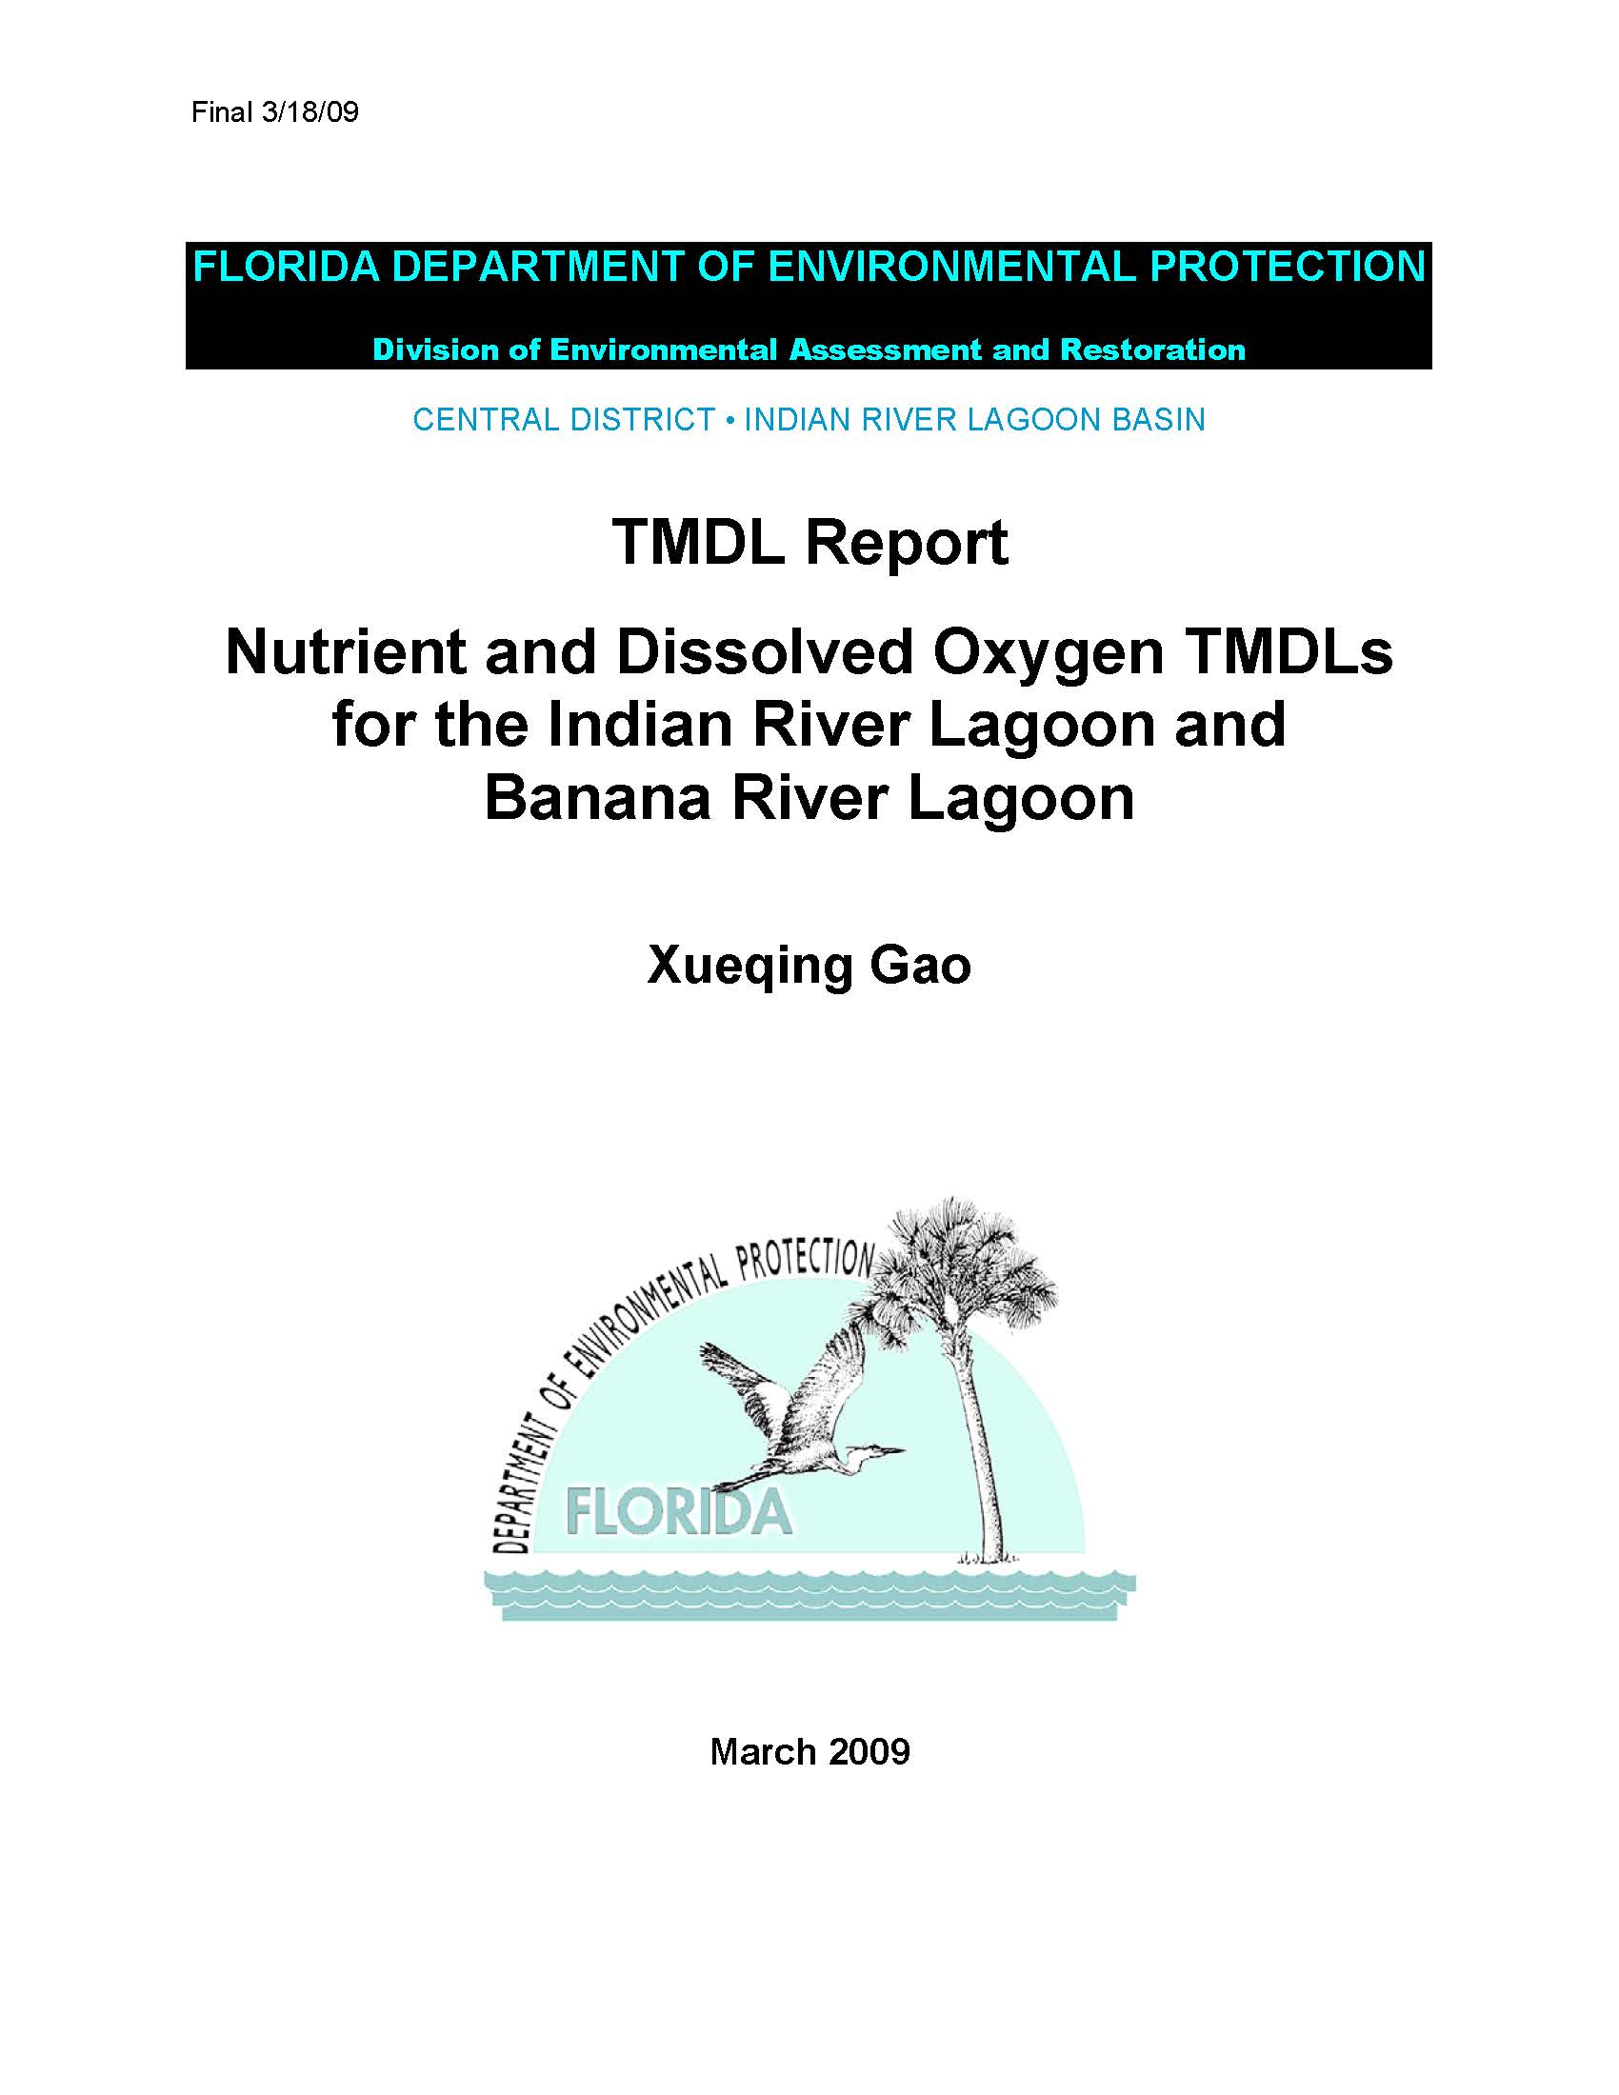
Total Maximum Daily Loads
A TMDL is a scientific determination of the maximum amount of a given pollutant that a surface water can absorb and still meet the water quality standards that protect human health and aquatic life.
Notes:
TMDL Process:
Assess the quality of surface waters-are they meeting water quality standards? (Determine which waters are impaired-that is, which ones are not meeting water quality standards for a particular pollutant or pollutants. (Impaired Waters Rule (IWR) - Chapter 62-303).
Establish and adopt, by rule, a TMDL for each impaired water for the pollutants of concern-the ones causing the water quality problems. (TMDLs - Chapter 62-304).
Develop, with extensive local stakeholder input, Basin Management Action Plans (BMAPs) that:
Implement the strategies and actions in the BMAP.
Measure the effectiveness of the BMAP, both continuously at the local level and through a formal re-evaluation every five years.
Adapt-change the plan and change the actions if things aren't working.
Reassess the quality of surface waters continuously.

Slide 6
Total Maximum Daily Loads Process
Assess the quality of surface waters - are they meeting water quality standards? (Determine which waters are impaired-that is, which ones are not meeting water quality standards for a particular pollutant or pollutants. (Impaired Waters Rule (IWR) - Chapter 62-303).
Establish and adopt, by rule, a TMDL for each impaired water for the pollutants of concern-the ones causing the water quality problems. (TMDLs - Chapter 62-304).
Develop, with extensive local stakeholder input, Basin Management Action Plans (BMAPs) that:
Implement the strategies and actions in the BMAP.
Measure the effectiveness of the BMAP, both continuously at the local level and through a formal re-evaluation every five years.
Adapt-change the plan and change the actions if things aren't working.
Reassess the quality of surface waters continuously.
Notes:
TMDL Process:
Assess the quality of surface waters-are they meeting water quality standards? (Determine which waters are impaired-that is, which ones are not meeting water quality standards for a particular pollutant or pollutants. (Impaired Waters Rule (IWR) - Chapter 62-303).
Establish and adopt, by rule, a TMDL for each impaired water for the pollutants of concern-the ones causing the water quality problems. (TMDLs - Chapter 62-304).
Develop, with extensive local stakeholder input, Basin Management Action Plans (BMAPs) that:
Implement the strategies and actions in the BMAP.
Measure the effectiveness of the BMAP, both continuously at the local level and through a formal re-evaluation every five years.
Adapt-change the plan and change the actions if things aren't working.
Reassess the quality of surface waters continuously.

Slide 7
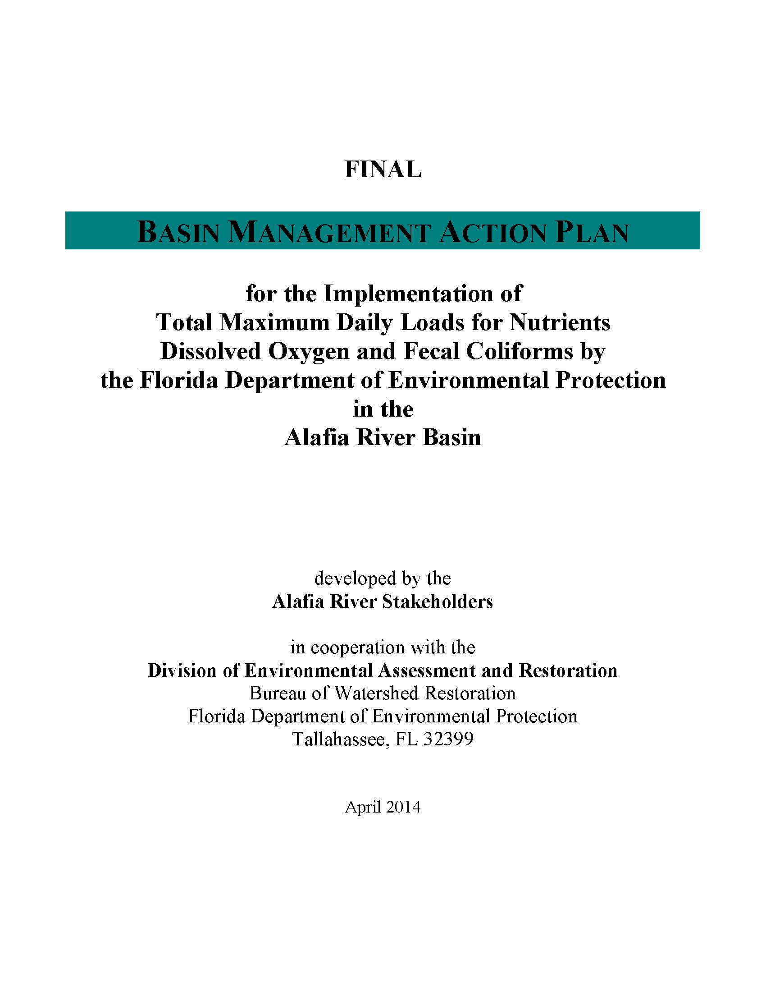
Basin Management Action Plans
A basin management action plan (BMAP) is a framework for water quality restoration.
contains local and state commitments to reduce pollutant loading.
These broad-based plans are developed with local stakeholders.
Notes:
BMAPs contain a comprehensive set of solutions, such as permit limits on wastewater facilities, urban and agricultural best management practices, and conservation programs designed to achieve pollutant reductions established by a total maximum daily load (TMDL).
BMAPs are adopted by Florida Department of Environmental Protection Secretarial Order and are legally enforceable.

Slide 8
TMDLs, BMAPs, (and Other Acronyms)
Having an impaired waterbody in your County can affect you significantly.
Before a Total Maximum Daily Load (TMDL) is adopted, water quality data is reviewed by the State. If you collect such data, it is important to provide it to the State.
Staff should attend public hearings on TMDLs and participate in Basin Management Action Plan (BMAP) meetings.
BMAPs can contain load reduction allocations for your County!

Slide 9
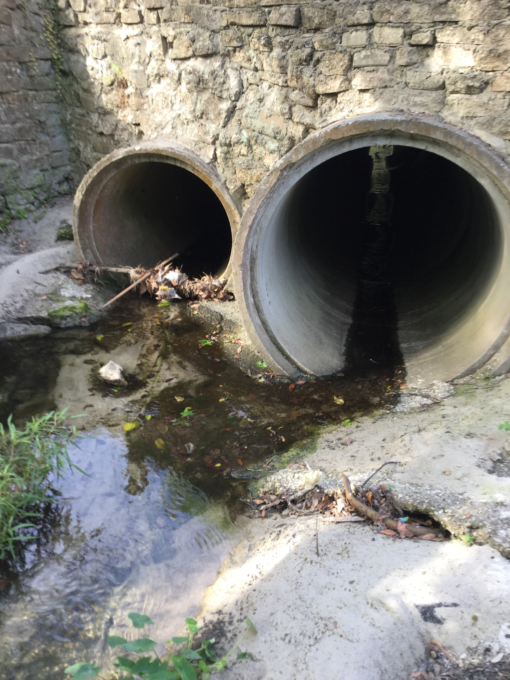
National Pollution Discharge Elimination System (NPDES)
The NPDES permit program was created in 1972 by the Clean Water Act (CWA).
The NPDES program in Florida has been delegated to the State.
Illicit Connection
Stormwater Outfall
Notes:
Federal laws also affect stormwater regulation in Florida.
The NPDES permit program, created in 1972 by the Clean Water Act (CWA), helps address water pollution by regulating point sources that discharge pollutants to waters of the United States.
Under the CWA, EPA authorizes the NPDES permit program to state, tribal, and territorial governments, enabling them to perform many of the permitting, administrative, and enforcement aspects of the NPDES program.
Communities that operate Municipal Separate Stormwater Systems (MS4) are divided into Phase 1 and Phase 2 communities based on population. Permits to operate an MS4 are issued through the State Department of Environmental Protection and require communities to take certain actions.
For example Phase 1 communities have to perform water quality sampling at the points where stormwater runoff is discharged to water bodies. An example for Phase 2 communities is the adoption of local ordinances addressing illicit connections to stormwater systems.
Permits are reviewed every 5 years so ensuring that permit requirements are being met is critical. If your county is not yet required to have a permit it may be required in the future as your population grows. You will be a Phase 2 community first.

Slide 10
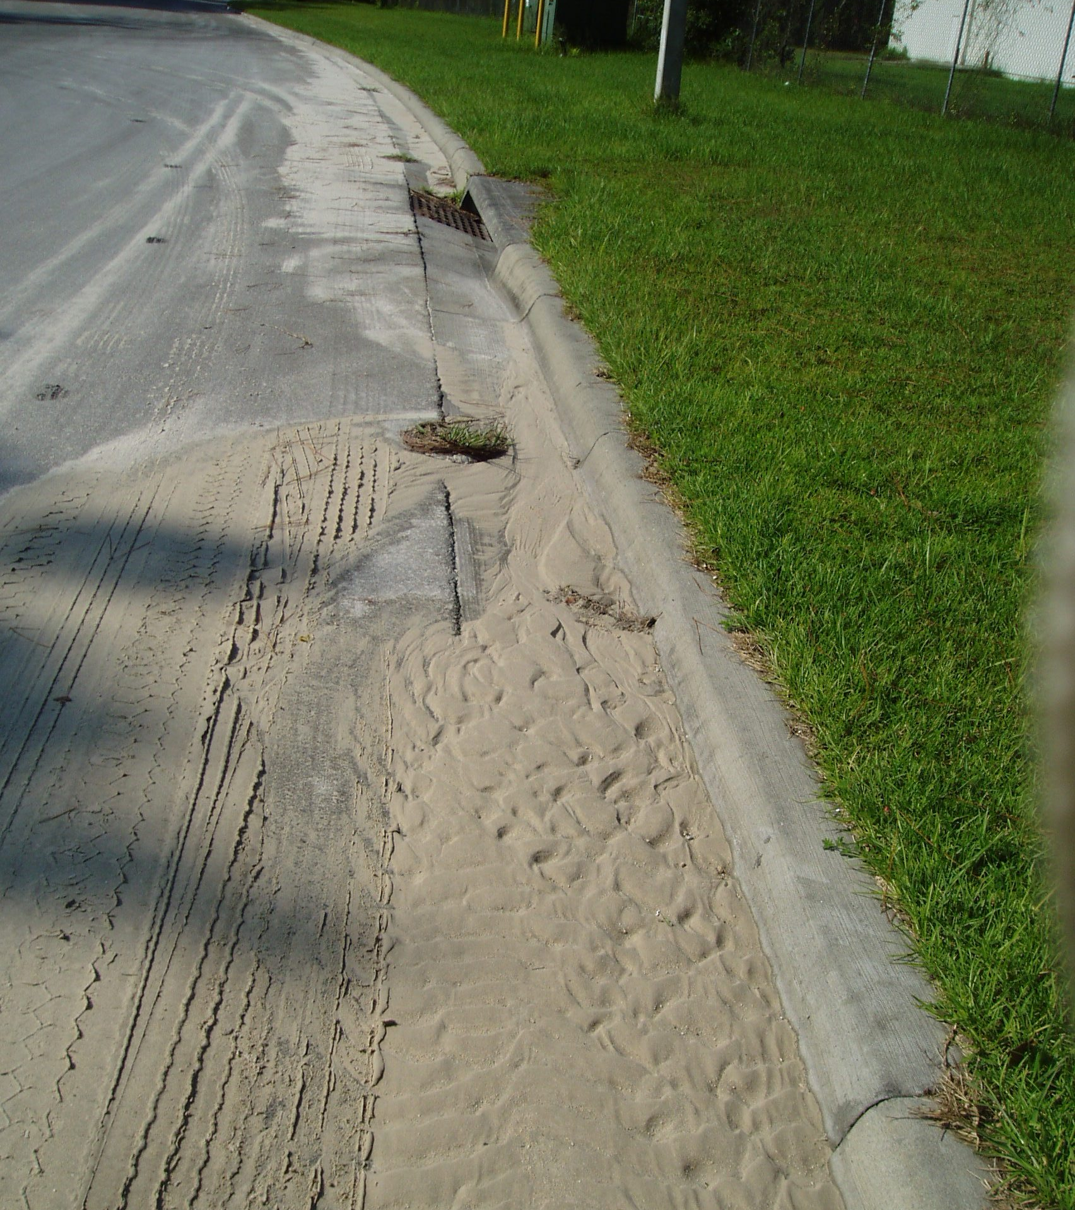
Construction Runoff
Notes:
Part of the State’s NPDES program is the prevention of erosion and sedimentation from construction sites. The State regulates construction activities that:
Disturb at least one or more acres of land or disturb less than one acre of land but are part of a common plan of development or sale (CGP Section 8.3).
Discharge stormwater to surface waters of the state or to surface waters of the state through a municipal separate storm sewer system (MS4).
If your County is required to have an NPDES permit you will be required to adopt and enforce local erosion and sedimentation rules that mirror the states.
These are some examples of erosion and sedimentation violations. Sedimentation on roads can be a liability!

Slide 11
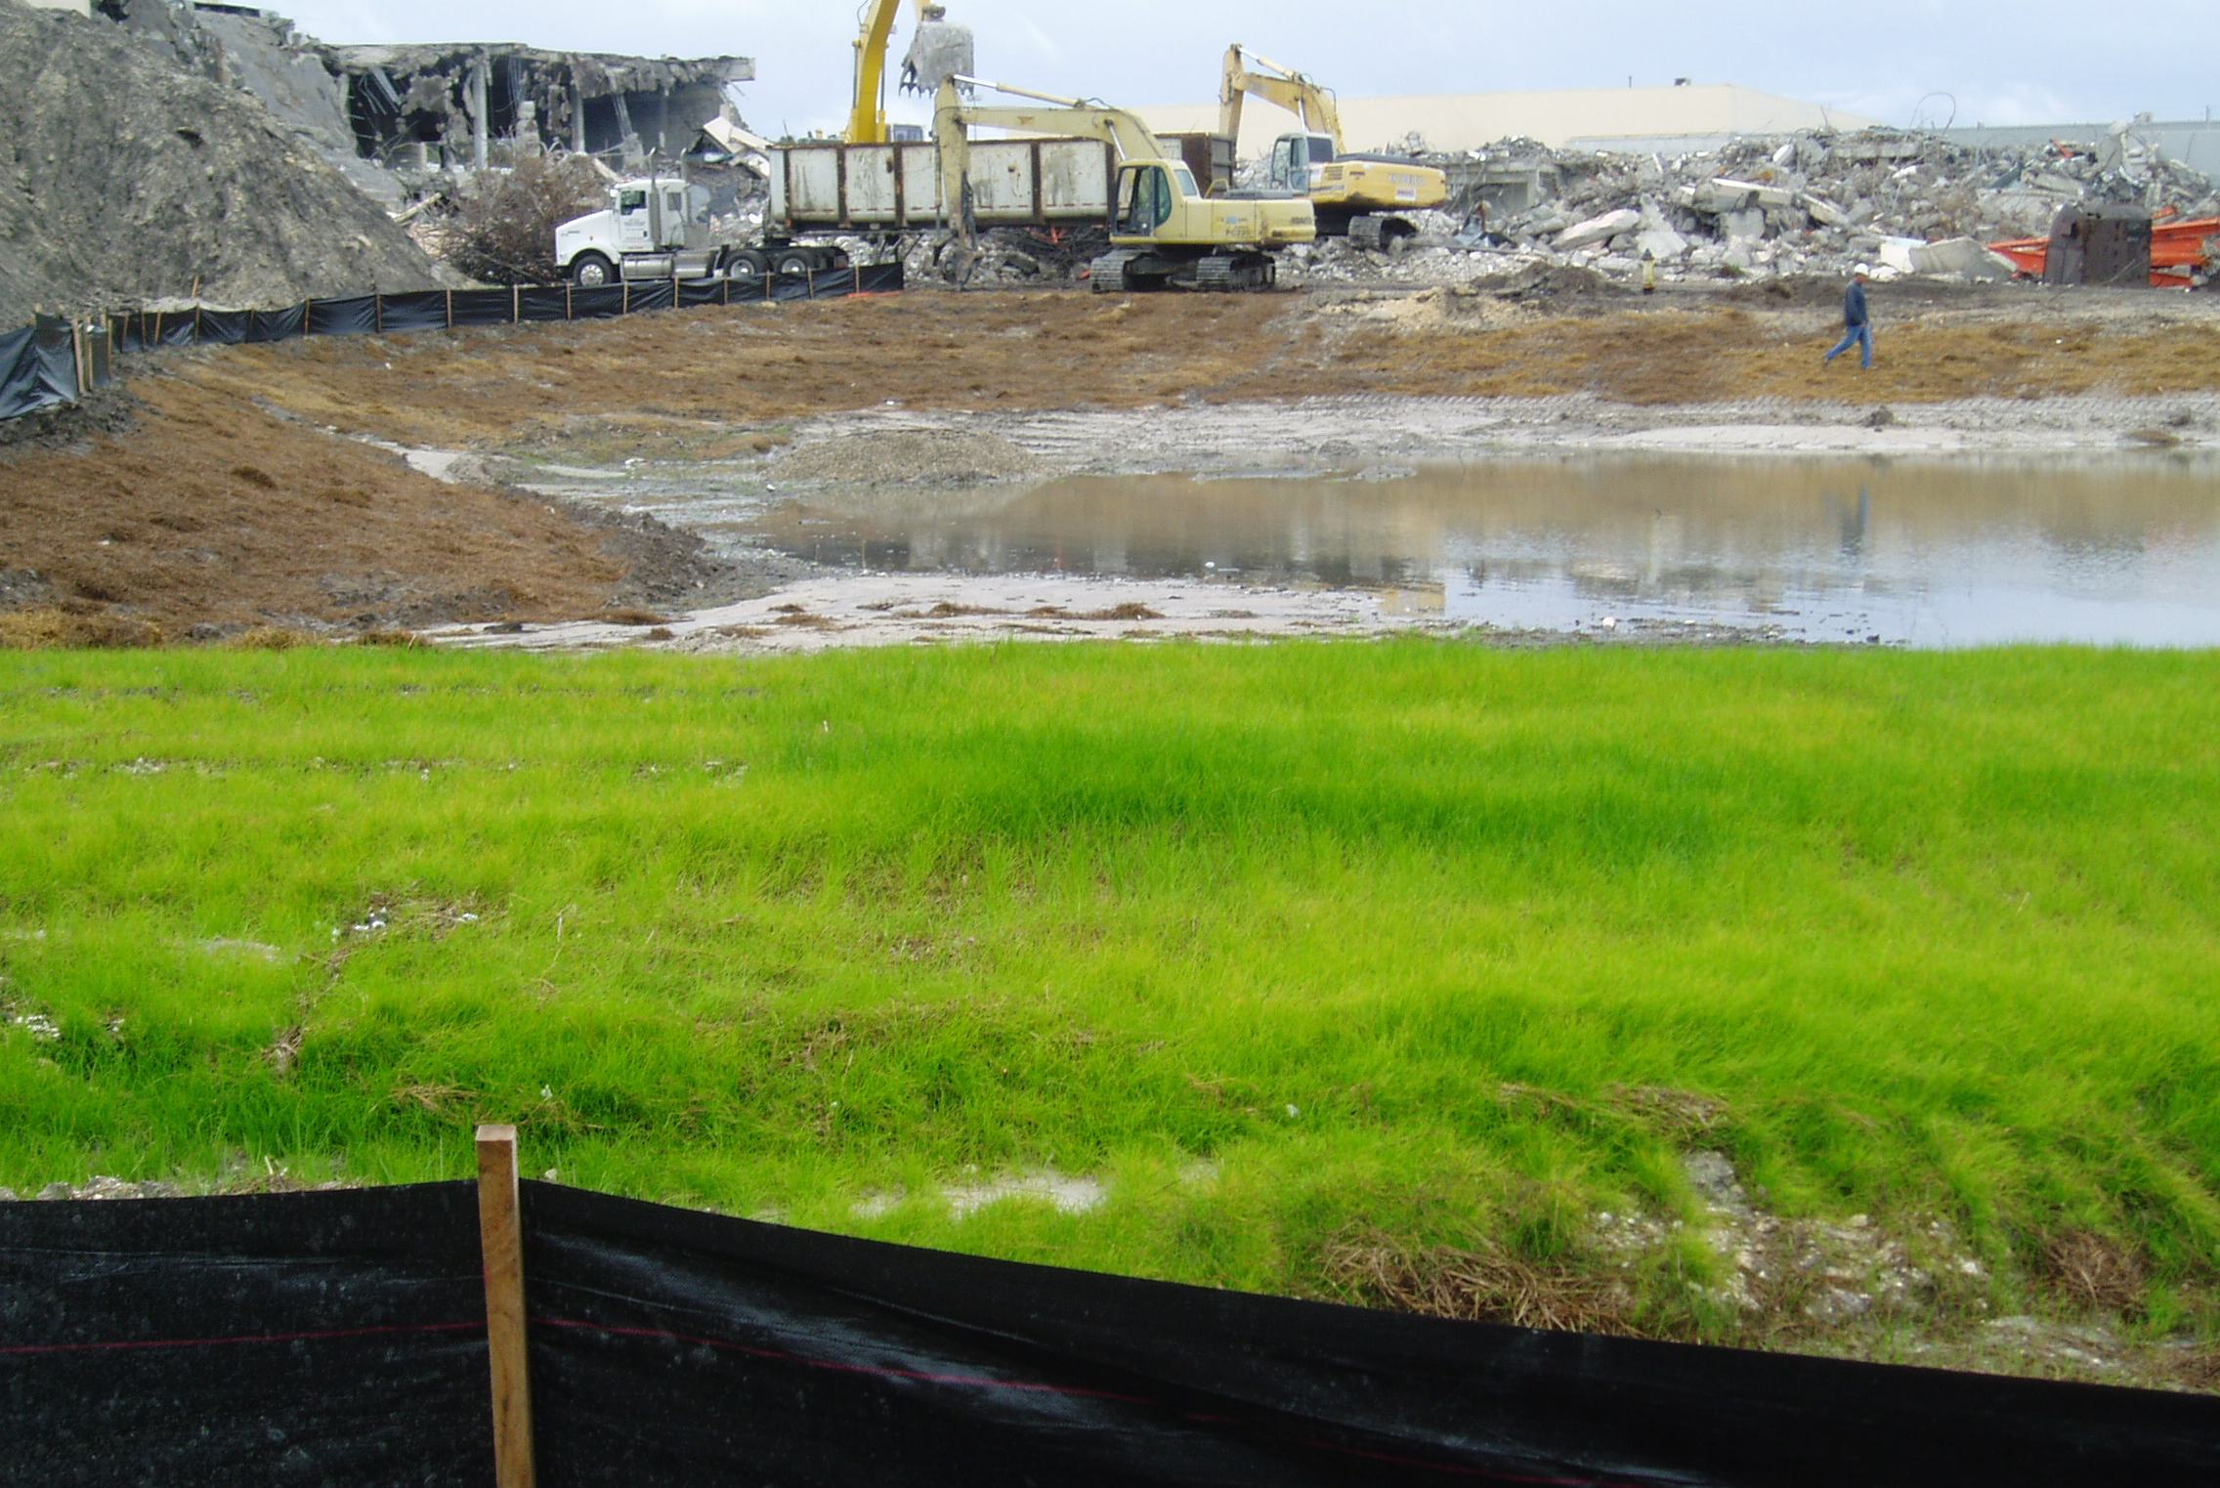
Construction Runoff
Notes:
These are examples of good construction runoff practices. To inspect construction sites for compliance, your staff should be certified through the State’s Stormwater Erosion and Sediment Inspector training.
Staff involved in maintenance work can take the operator portion of the class that focuses on proper installation of erosion and sediment controls.

Slide 12
Stormwater Program Funding
403.0893 Stormwater funding; dedicated funds for stormwater management.—In addition to any other funding mechanism legally available to local government to construct, operate, or maintain stormwater systems, a county or municipality may:
(1) Create one or more stormwater utilities and adopt stormwater utility fees sufficient to plan, construct, operate, and maintain stormwater management systems set out in the local program required pursuant to s. 403.0891(3);
(2) Establish and set aside, as a continuing source of revenue, other funds sufficient to plan, construct, operate, and maintain stormwater management systems set out in the local program required pursuant to s. 403.0891(3); or
(3) Create, alone or in cooperation with counties, municipalities, and special districts pursuant to the Interlocal Cooperation Act, s. 163.01, one or more stormwater management system benefit areas. For fees assessed pursuant to this section, counties or municipalities may use the non-ad valorem levy, collection, and enforcement method as provided for in chapter 197.

Slide 13
Assessment vs Utility
A stormwater utility charges a fee for a service, such as the use of the stormwater management system for runoff from a property.
Usually based on impervious area on the property
Usually billed with other utility services (water and wastewater)
An assessment is a charge on a property based on the theory that the property receives a benefit from the activities performed with the proceeds of the assessment.
Billed annually on tax bill
Can be based on impervious area

Slide 14
HB 53 – Statewide 20-year Stormwater Needs Assessment
Requires a 20-year assessment of stormwater funding needs
Repeated every five years; first cycle collected in 2022.
Response may help with getting State funding in the future
$62 billion in needs identified spilt evenly between flooding and water quality.

Slide 15
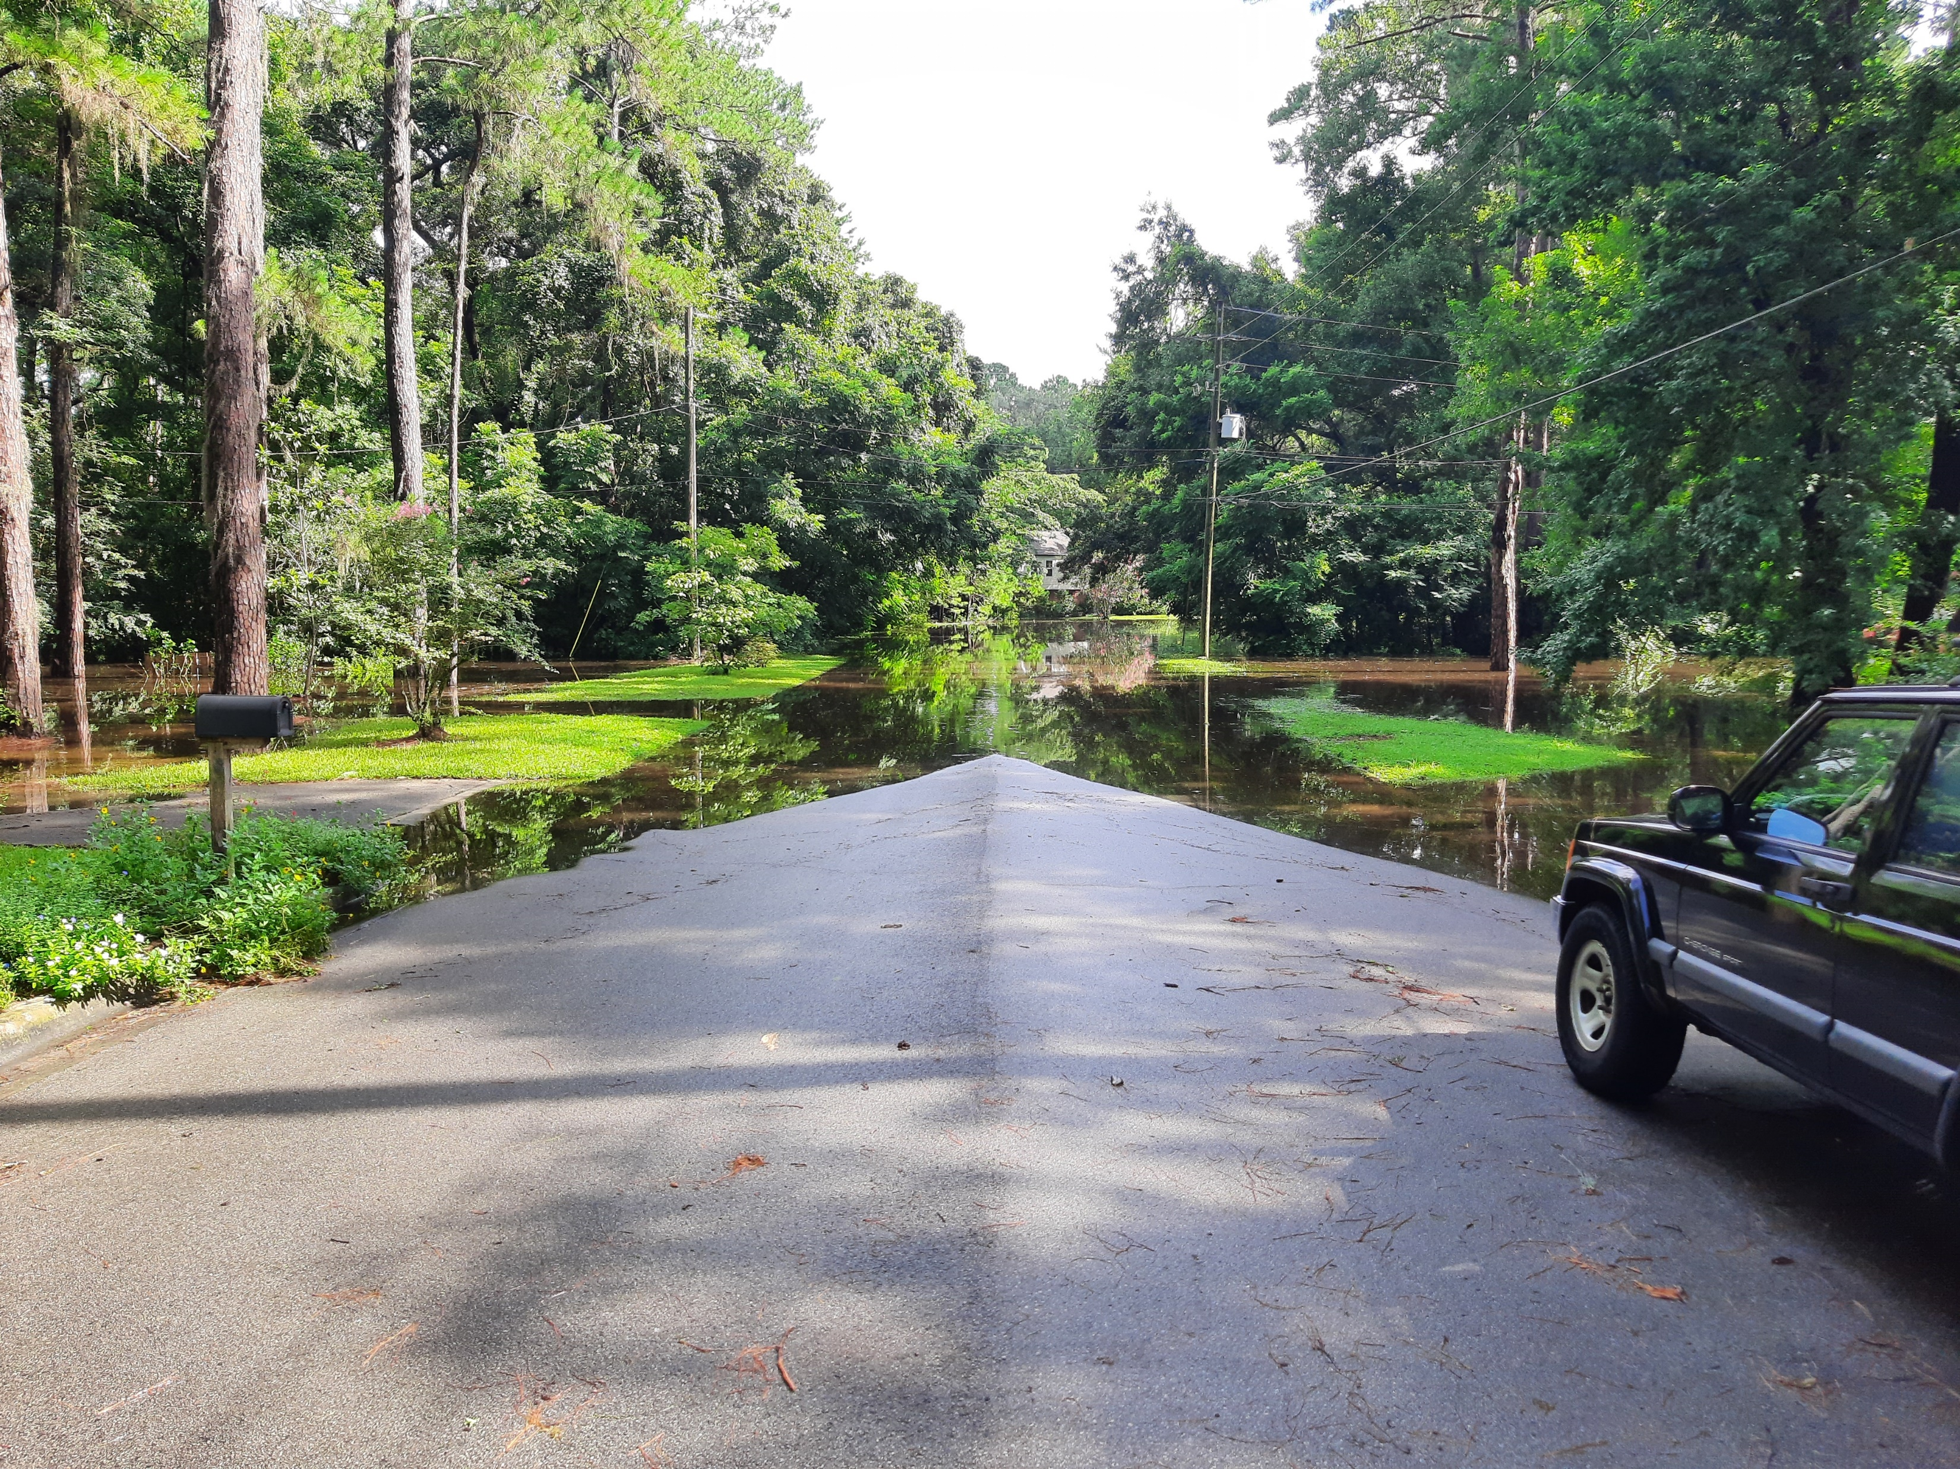
Local Stormwater Regulation
Local regulation exceeding state standards can be implemented to address community goals for stormwater quality and flooding.
Higher standards can contribute to higher ratings in the FEMA Community Rating System which influences flood insurance premiums.
Consider current development under future conditions

Slide 16
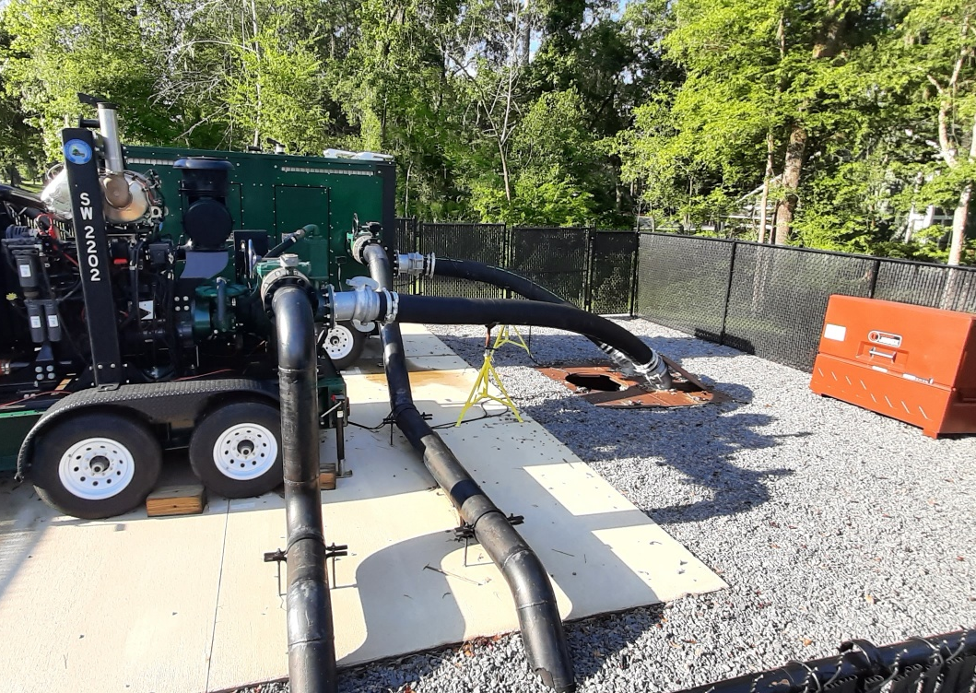
Local Stormwater Investments
Gain community support
Create tangible benefits
Mitigation for legacy flooding issues is challenging – set achievable goals
Grant funding available - State and Federal

Slide 17
Local Stormwater Regulation
Local regulation exceeding state standards can be implemented to address community goals for stormwater quality and flooding.
Higher standards can contribute to higher ratings in the FEMA Community Rating System which influences flood insurance premiums.
Consider current development under future conditions

Slide 18
Stormwater Treatment Facilities

Slide 19
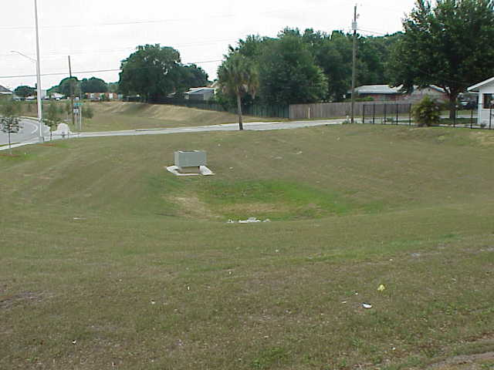
Dry Retention Basin with Control Structure

Slide 20
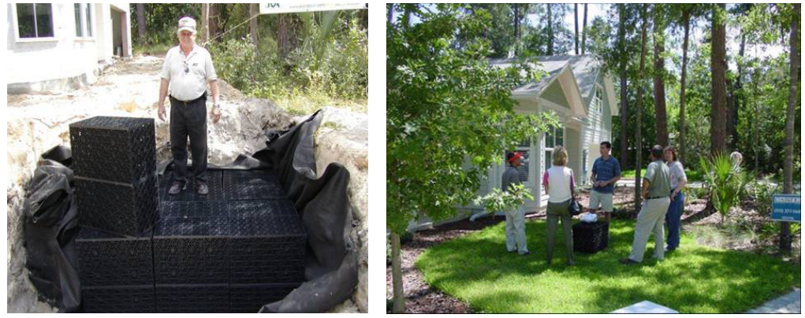
Exfiltration Trench

Slide 21
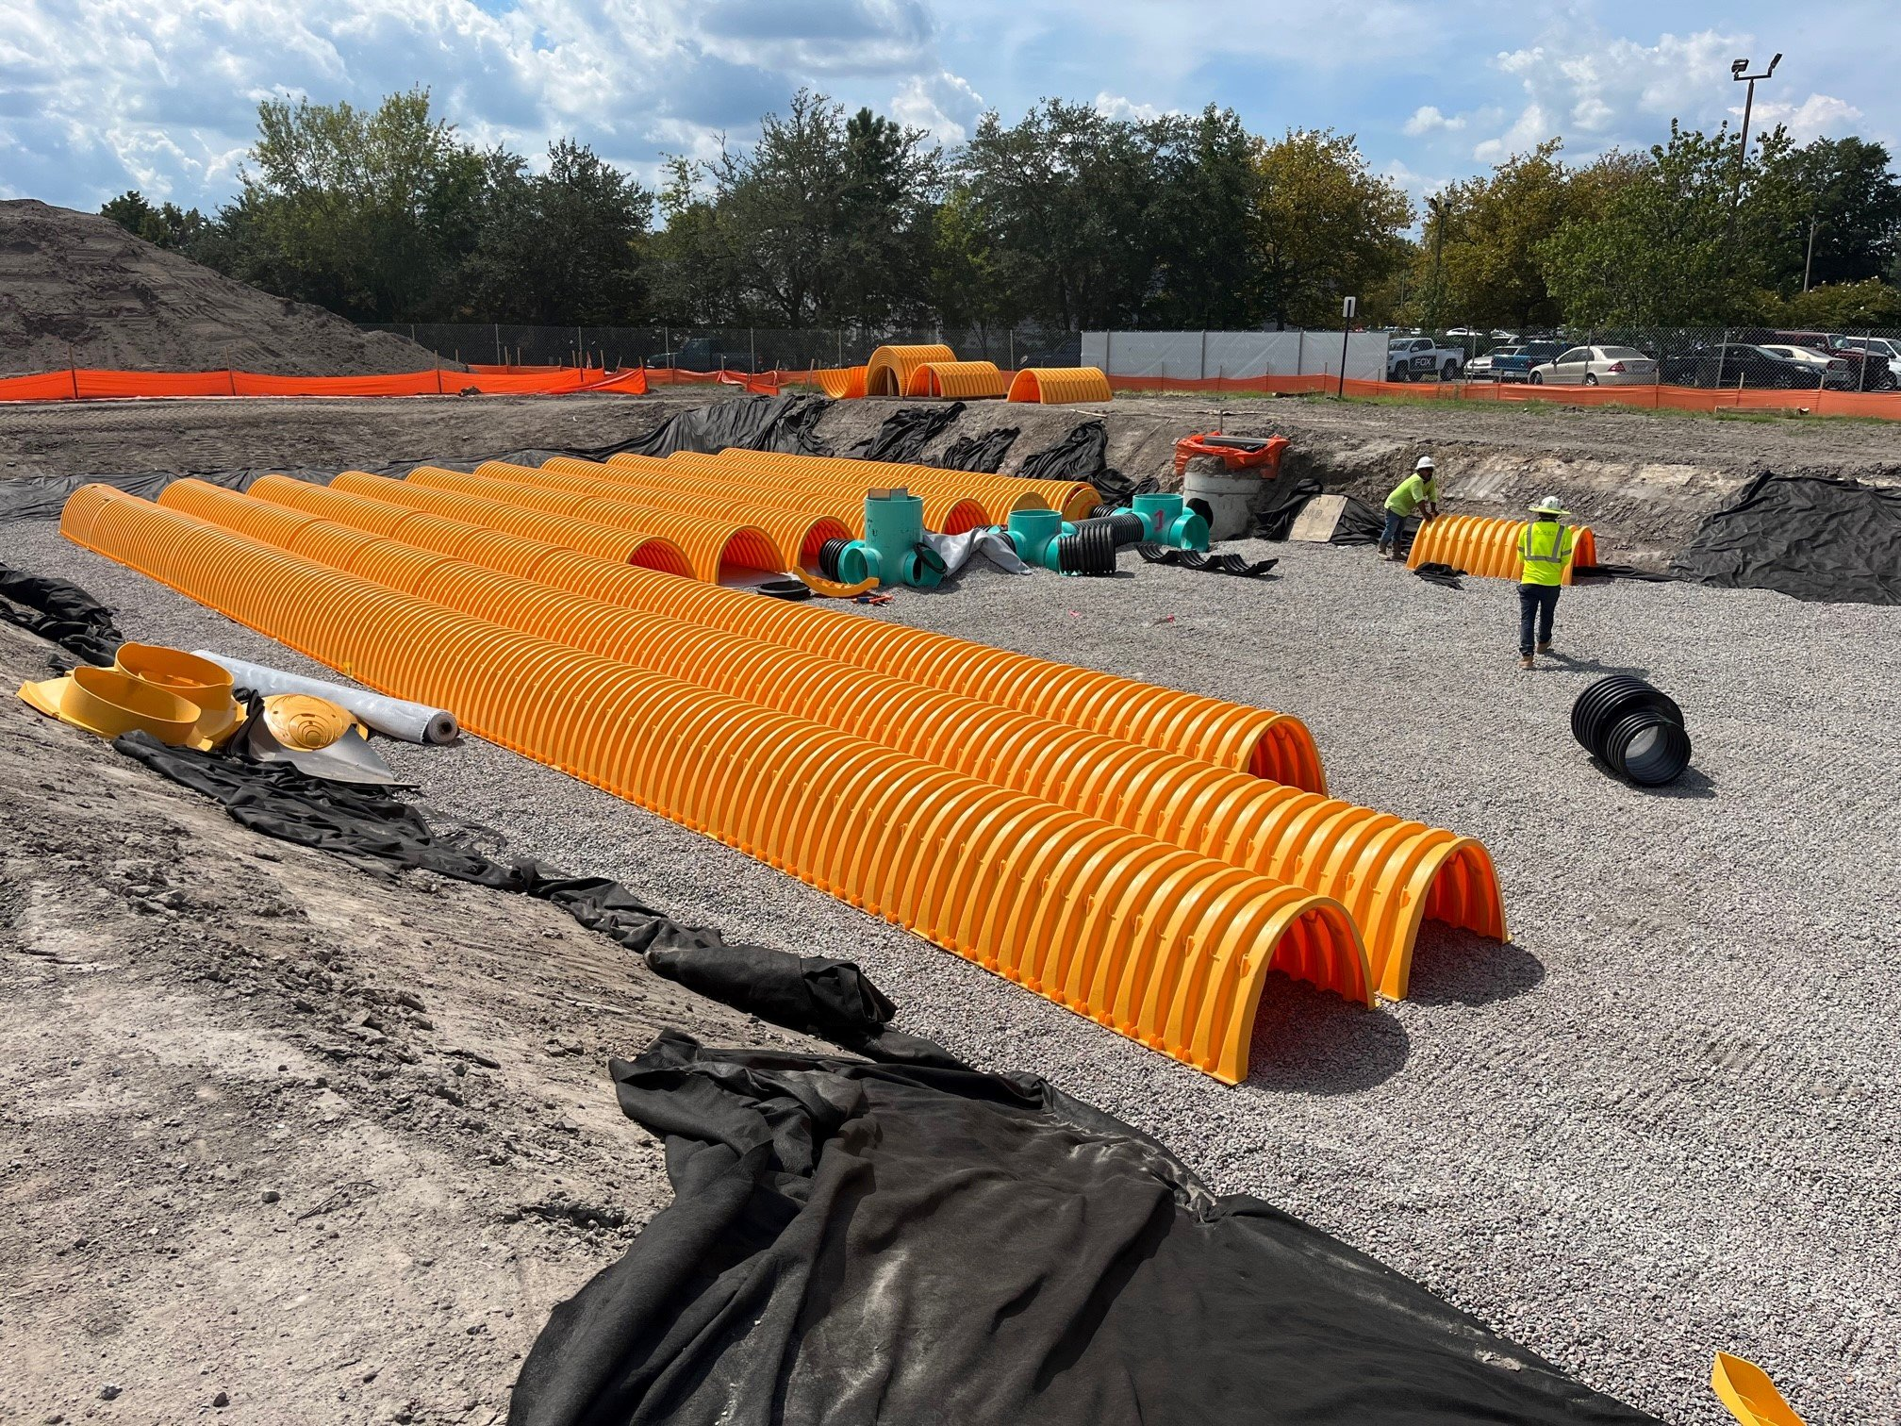
Underground Retention System

Slide 22
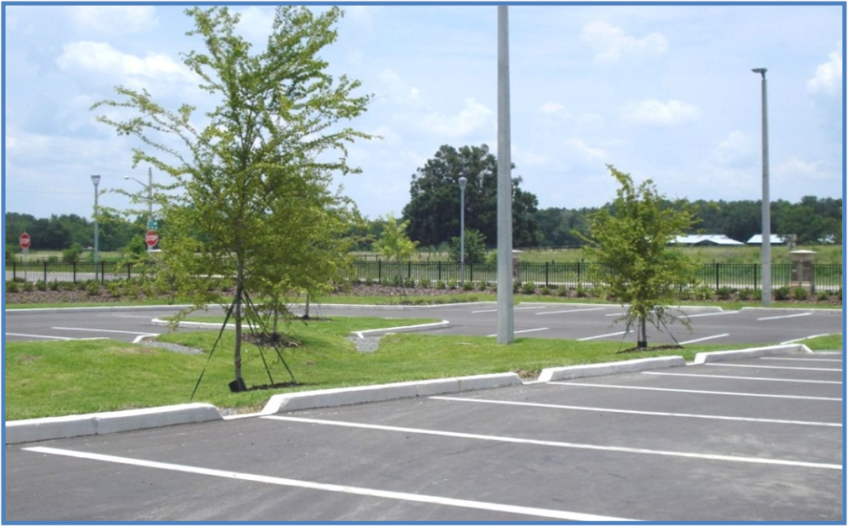
Depressed Island Retention Basin BMP for Additional Treatment and Storage

Slide 23
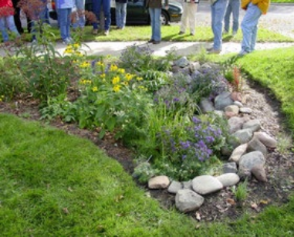
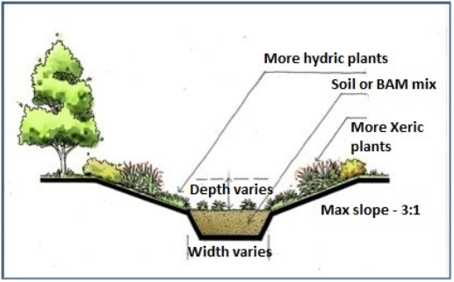
Rain Garden

Slide 24
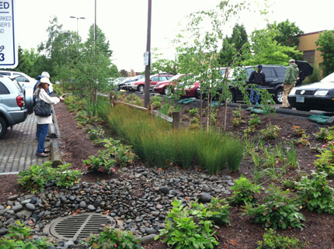
Treatment Swale

Slide 25
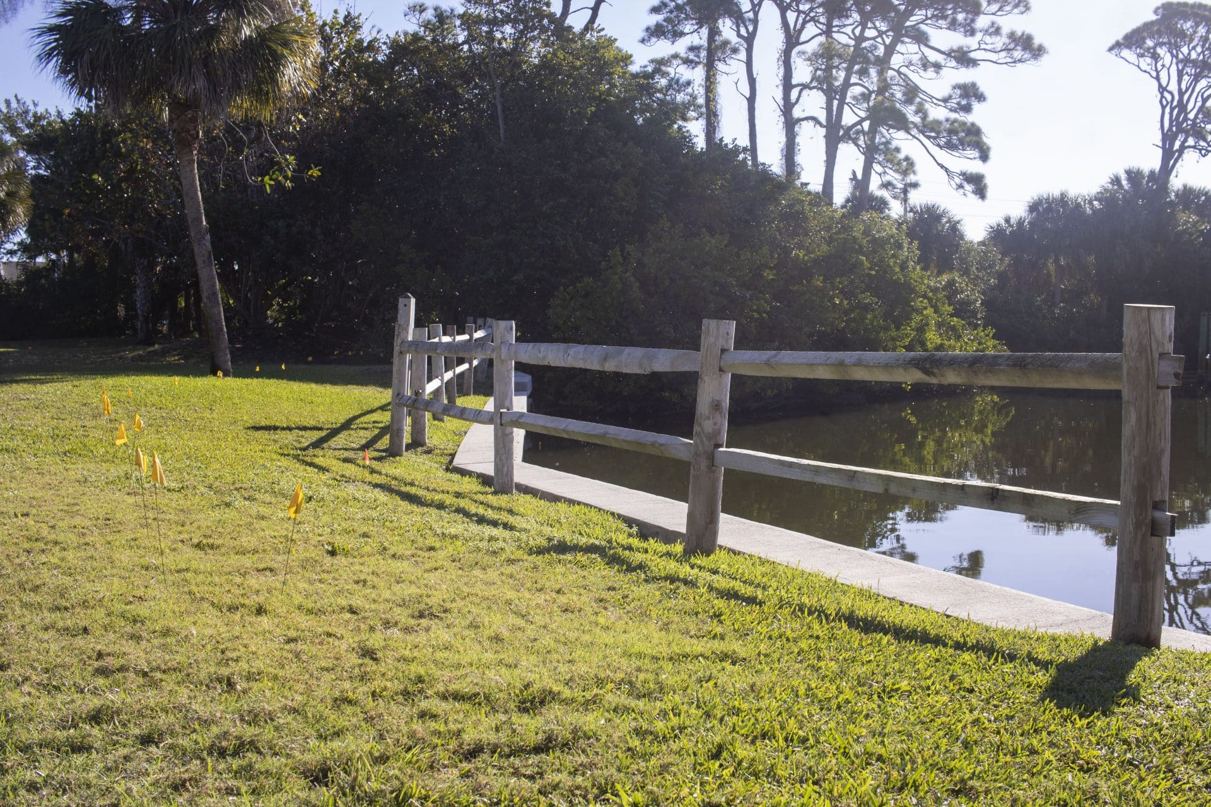
Vegetated Natural Buffer

Slide 26
Pervious Pavement

Slide 27
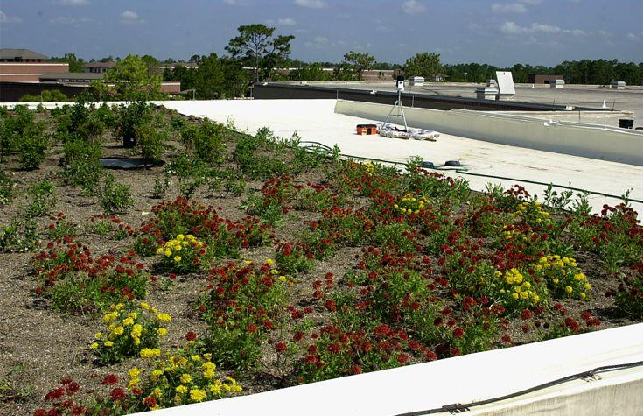
Green Roof

Slide 28
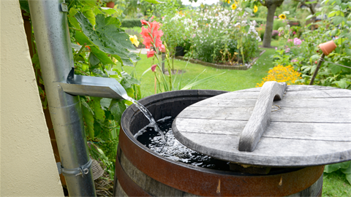
Rainwater Harvesting Cistern

Slide 29
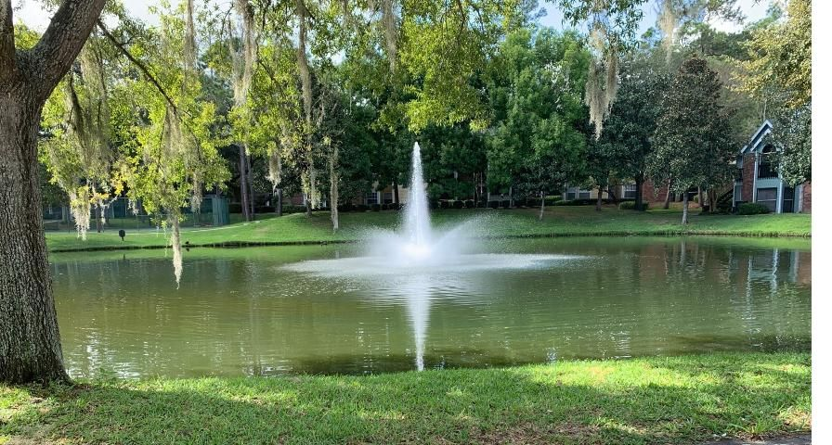
Wet Detention Pond

Slide 30
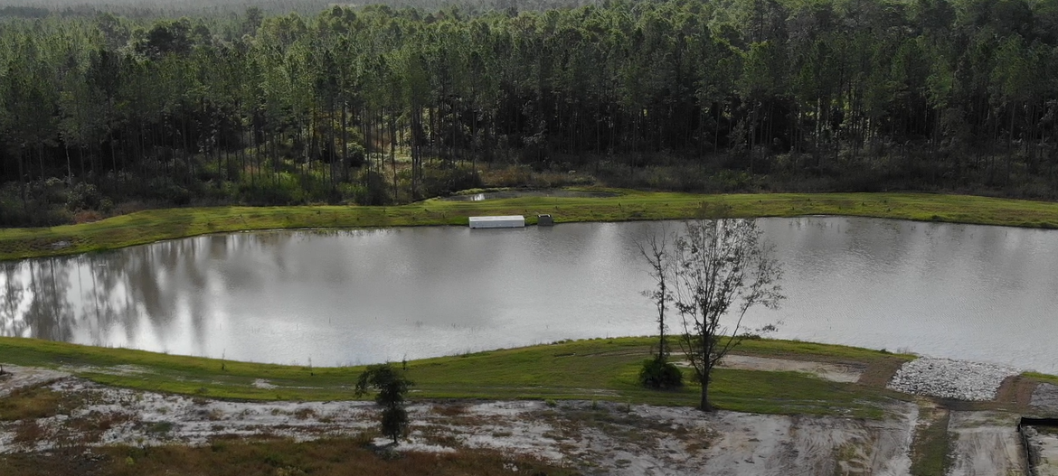
Biosorption Activated Media (BAM) Filter
Notes:
Treats base flow with engineered media that provides removal of pollutants, especially nutrients.

Slide 31
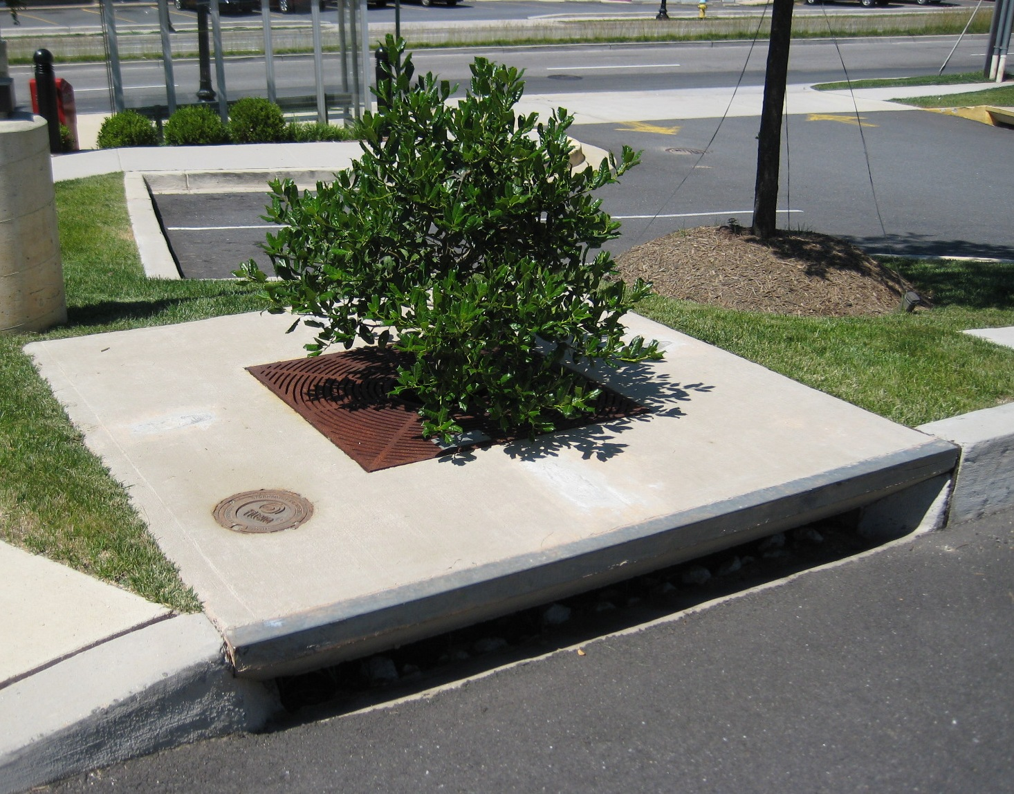
Tree Box Filter

Slide 32
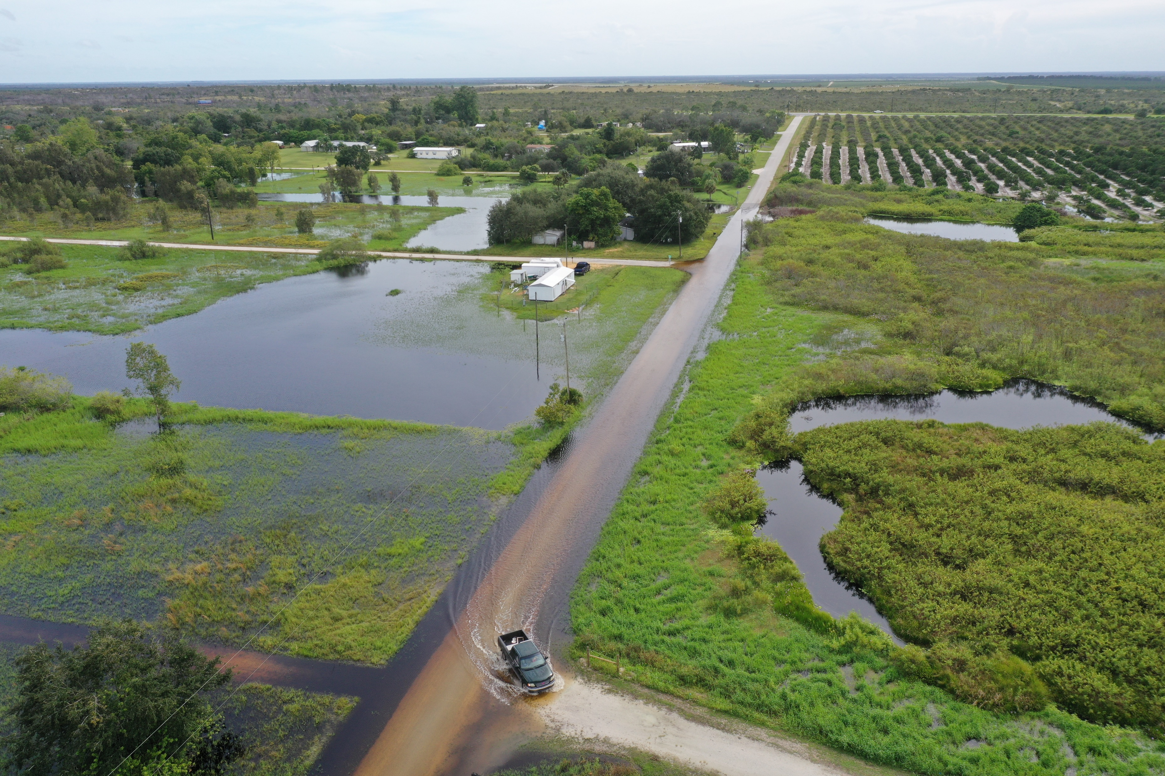
Stormwater Do’s and Don’ts
DON’T: Ignore changes in State and Federal regulations.
DON’T: Ignore correspondence from the State regarding permits, TMDLs, BMAPs. Etc!
DON’T: Make unrealistic commitments as far as projects!
DON’T: Be afraid to hire outside help setting up your funding mechanism.

Slide 33
Knowledgeable Staff are Critical
Having at least one staff member who is familiar with the requirements of State and Federal programs will save a lot of trouble!
For example, NPDES permits require that a County perform and document certain activities such as outreach and education efforts.
Also, there are MANY grant opportunities, especially for water quality projects. They all have different requirements.

Slide 34
Ramon D. Gavarrete, P.E.
Public Works Director / County Engineer
Alachua County, Florida
rgavarrete@alachuacounty.us
(863) 381-6875

