Slide 1
Maximizing the Beneficial Impact of the SEP

Slide 2
Total Florida Settlement
State | Dollars | Percent
RA Direct Component (Pot 1) | $364,000,000 | 11%
RA Spill Impact Component (Pot 3) | $286,000,000 | 8%
RA Center of Excellence (Pot 5) | $26,000,000 | 1%
Natural Resource Damages | $680,000,000 | 20%
Economic Damages | $2,000,000,000 | 60%
Total | $3,356,000,000

Slide 3
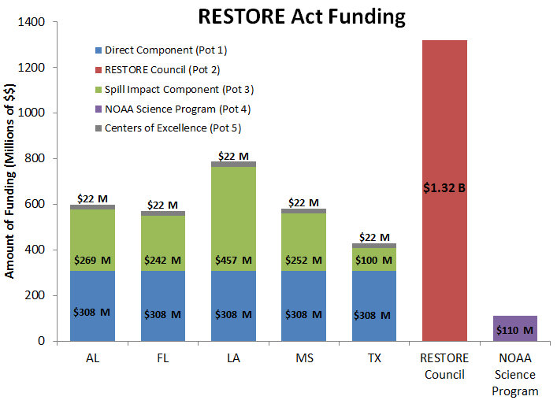
Major Source of Leveraging
Note: BPXP settlement only
Source: Environmental Law Institute

Slide 4
Total Florida Settlement
Economic Recovery
(75% to Panhandle)
Ecological/Recreational Restoration
(Panhandle Focused)
County Discretionary Use
Scientific Research
(Statewide)

Slide 5
Florida Direct Component
Note: Includes Transocean + BPXP settlements
Source: Erin Deady

Slide 6
Total Florida Settlement
It’s Up to You!

Slide 7
What Makes Sense for the SEP?
Environmental focus targeting
Estuaries and coastal waters
Regionally significant projects
Water quality improvement
Nutrient & sediment load reduction
Hydrologic restoration
Habitat restoration
Seagrass recovery
Pot 2 and NRDA funds can be leveraged for water quality improvement

Slide 8
Maximizing Impact
Scenario 1
$286M ÷ 23 counties = $12.4M/county
= $12.4M ÷ 15 years = $829K county/year
Scenario 2
$286M ÷ 15 years = $19M/year over 15 years
= 15 regionally significant projects each ~$19M+
Regionally significant project are more likely to attract leveraged funds
Council-Selected Component (Pot 2)

Slide 9
What are Regionally Significant Projects?
Projects that deliver benefits that extend beyond the boundaries of a single county
Projects conducted across two or more adjacent counties
Example: Regional beneficial reuse of Tampa AWT wastewater
Projects conducted within the boundaries of a single county that generate regional benefits
Example: Naples Bay/Rookery Bay restoration

Slide 10
Beneficial Reuse of Tampa AWT wastewater
Regional Benefits
Major nitrogen load reduction from Tampa Bay
Rehydration of Crews Lake and the upper Pithlachascotee River
Recharge of regional potable water wellfields and affected lakes and wetlands

Slide 11
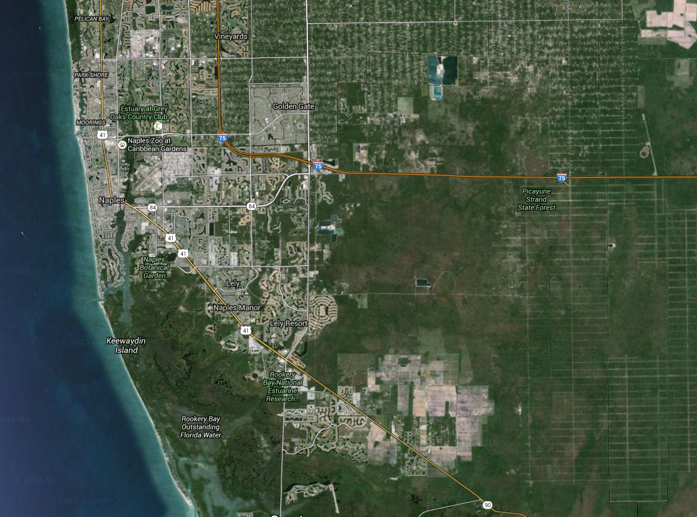
Naples Bay/Rookery Bay Restoration
Regional Benefits
Major nutrient load reduction from Naples Bay
Restoration of natural salinity patterns in Naples Bay and Rookery Bay
Re-establishment of native oyster bars
Seagrass recovery

Slide 12
Potential Sources of Leverage
Other Restore Act sources (Pots 1 and 2)
Individual county economic settlements
Other DWH settlement sources
Triumph Gulf Coast = economic projects
NFWF = environmental projects
NRDA = environmental and recreational projects
State/regional agency sources
FDEP
319 grants = stormwater
Amendment 1 = land acquisition
Water Management Districts
SWIM Program funds
Local government cooperative funding
Panhandle focused

Slide 13
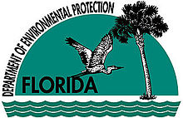
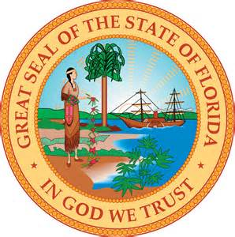
County-Independent SEP Development Process
DEP Project Portal
Potential Projects
Sort, screen, map, evaluate & rank
Projects
Final SEP Submitted to the Council
Draft SEP

Slide 14
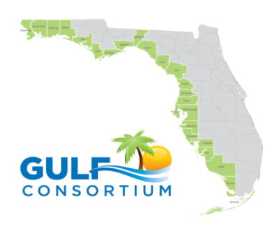
County-Driven SEP Development Process
Individual Counties
Potential Projects
Conceptual Designs & Feasibility Studies
Final SEP Submitted to the Council
Grant-Ready
Draft SEP

